Slide 1


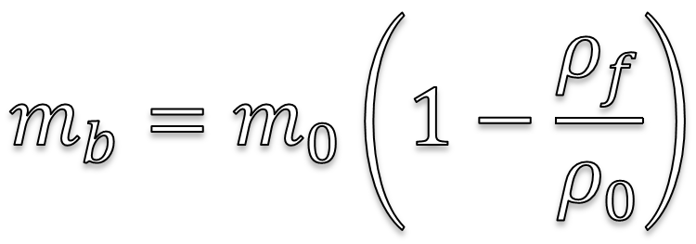
$$F_{s}= μ_{s}N$$
$$m_{b}=m_{0}\left(1−\frac{ρ_{f}}{ρ_{0}}\right)$$

Slide 2


Slide 3


C#
FOO
Table View ∙ Presentation ∙ Model
∞

Slide 4
>_
-
x
File Edit View Terminal Help

